Slide 1


<Carlos Bautista>
<10/21/24>

Slide 2

Outline
Executive Summary
Introduction
Methodology
Results
Conclusion
Appendix

Slide 3
Executive Summary
The goal of this project is to predict the successful landing of the Falcon 9 rocket’s first stage, a key factor in determining the cost-efficiency of a SpaceX launch. SpaceX advertises a launch cost of $62 million, significantly lower than competitors who charge upwards of $165 million. This price advantage largely stems from SpaceX's ability to reuse the first stage of the Falcon 9 rocket. By accurately predicting whether the first stage will land successfully, we can assess the associated launch costs.
This information is particularly valuable for potential competitors bidding against SpaceX for rocket launches, as it helps to quantify the cost benefits of reusable rockets. In this project, data is collected via an API, formatted, and analyzed to train a model that predicts landing success based on historical launch data. The project provides insights into the feasibility of reusability and its implications for the broader space industry.

Slide 4
Introduction
The goal of this project is to predict the successful landing of the Falcon 9 rocket’s first stage, a key factor in determining the cost-efficiency of a SpaceX launch. SpaceX advertises a launch cost of $62 million, significantly lower than competitors who charge upwards of $165 million. This price advantage largely stems from SpaceX's ability to reuse the first stage of the Falcon 9 rocket. By accurately predicting whether the first stage will land successfully, we can assess the associated launch costs.
This project focuses on predicting the likelihood of a successful landing for the Falcon 9 first stage. By analyzing historical data on previous launches, we aim to build a model that forecasts whether the first stage will land safely. Accurate predictions will not only help SpaceX further optimize its operations but also provide valuable insights for competitors interested in bidding for rocket launch contracts. With access to launch data via an API, this project seeks to understand the key factors influencing landing success and the broader implications for reducing the cost of space travel.

Slide 5

Section 1

Slide 6
Methodology
Executive Summary
Data collection methodology:
Data was sourced from IBM Skills Network
Perform data wrangling
Data was processed thru web scraping
Perform exploratory data analysis (EDA) using visualization and SQL
Perform interactive visual analytics using Folium and Plotly Dash
Perform predictive analysis using classification models
LogReg, Dtree, KNN, SVM

Slide 7
Data Collection
Data was collected through webscraping

Slide 8
Data Collection – SpaceX API
Present your data collection with SpaceX REST calls using key phrases and flowcharts
Add the GitHub URL of the completed SpaceX API calls notebook (must include completed code cell and outcome cell), as an external reference and peer-review purpose
Place your flowchart of SpaceX API calls here

Slide 9
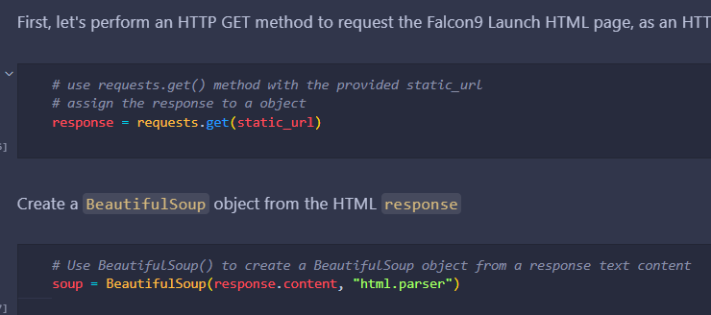
Data Collection - Scraping
IBM-Practice-Labs/Capstone Project 2/module 1 - Intro/web_scraping.py at main · CxLos/IBM-Practice-Labs
Place your flowchart of web scraping here

Slide 10
Data Wrangling
IBM-Practice-Labs/Capstone Project 2/module 1 - Intro/data_wrangling_spacex.py at main · CxLos/IBM-Practice-Labs

Slide 11
EDA with Data Visualization
IBM-Practice-Labs/Capstone Project 2/module 2 - EDA/labs/jupyter-labs-eda-dataviz-v2.ipynb at main · CxLos/IBM-Practice-Labs
During the EDA stage of this project, we made some charts using Folium to discover any correlations between the launch site and success rates.

Slide 12
EDA with SQL
IBM-Practice-Labs/Capstone Project 2/module 2 - EDA/labs/jupyter-labs-eda-sql-coursera_sqllite.ipynb at main · CxLos/IBM-Practice-Labs
During this stage of the project, we used SQL queries to display the launch sites, payload mass, find boosters with specific landing outcomes, and to find the number of successful mission outcomes.

Slide 13
Build an Interactive Map with Folium
Summarize what map objects such as markers, circles, lines, etc. you created and added to a folium map
Explain why you added those objects
Add the GitHub URL of your completed interactive map with Folium map, as an external reference and peer-review purpose

Slide 14
Build a Dashboard with Plotly Dash
IBM-Practice-Labs/Capstone Project 2/module 3 - Interactive Visual Analytics/labs/lab-jupyter-launch-site-location-v2.ipynb at main · CxLos/IBM-Practice-Labs
In this dashboard we created a successful landing pie chart by location as well as a scatter plot for payload.

Slide 15
Predictive Analysis (Classification)
IBM-Practice-Labs/Capstone Project 2/module 4 - Predictive Analysis/labs/SpaceX-Machine-Learning-Prediction-Part-5-v1.ipynb at main · CxLos/IBM-Practice-Labs
In the Predictive Analysis stage, We utilized Logistic Regression, Decision Tree, SVM and KNN machine learning models and determined the best parameters for each model as well as the best score in order to find out which method worked best.

Slide 16
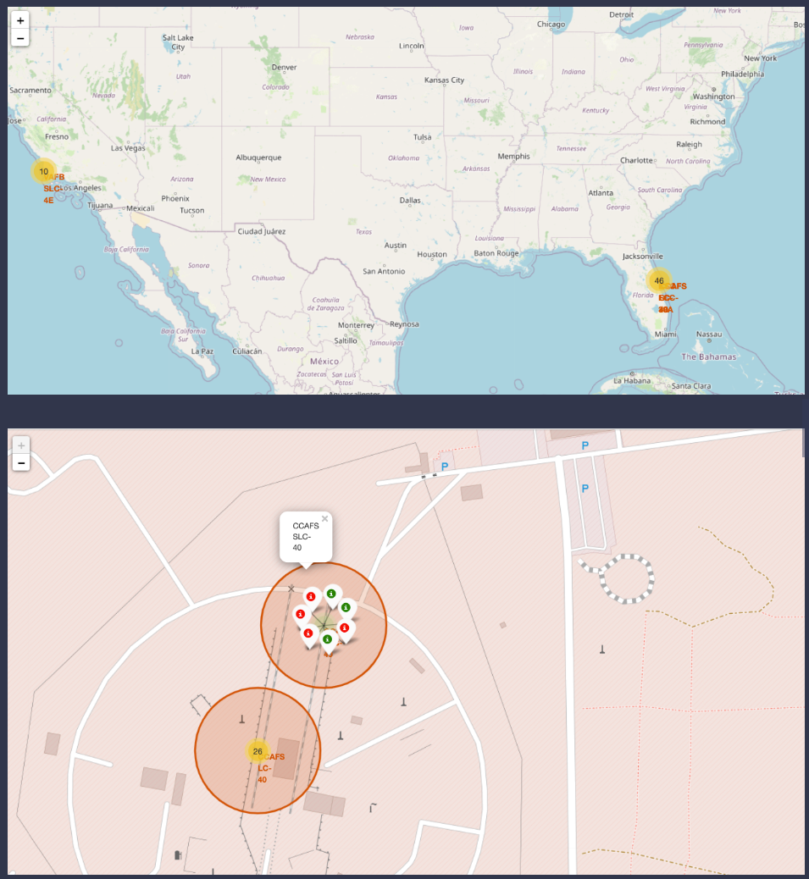
Results
Exploratory data analysis results
Predictive analysis results: Decision Tree was the best model for the dataset since it yielded the highest accuracy.

Slide 17

Section 2

Slide 18
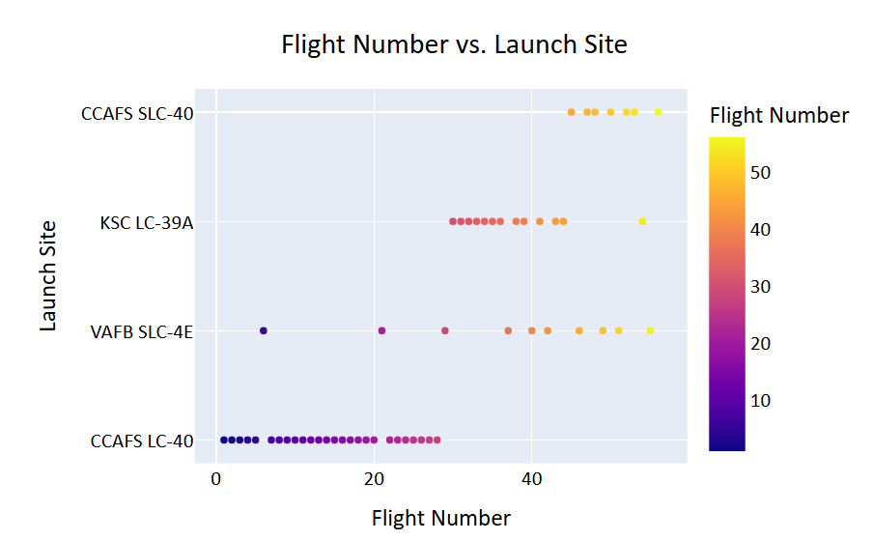
Flight Number vs. Launch Site

Slide 19
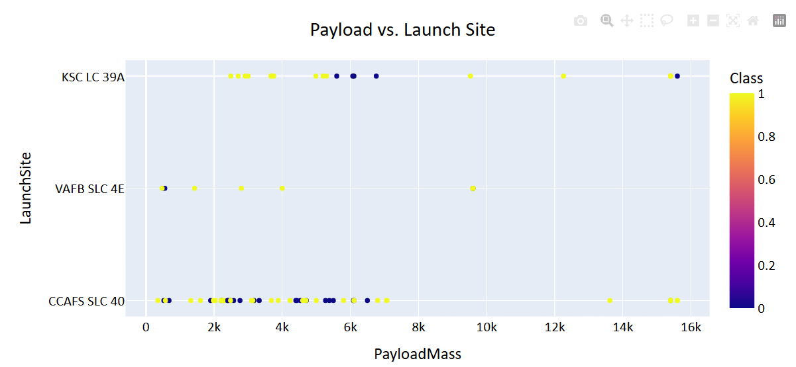
Payload vs. Launch Site

Slide 20
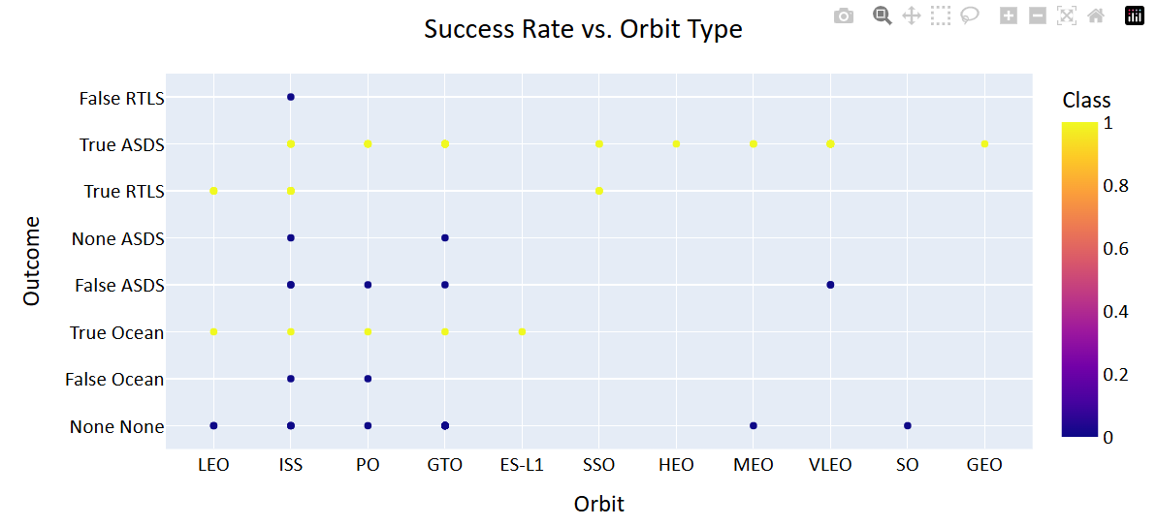
Success Rate vs. Orbit Type

Slide 21
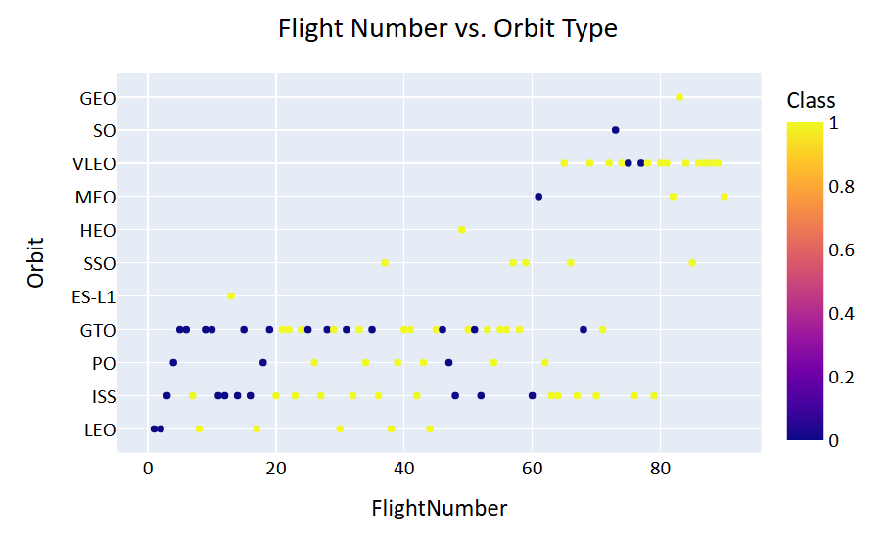
Flight Number vs. Orbit Type

Slide 22
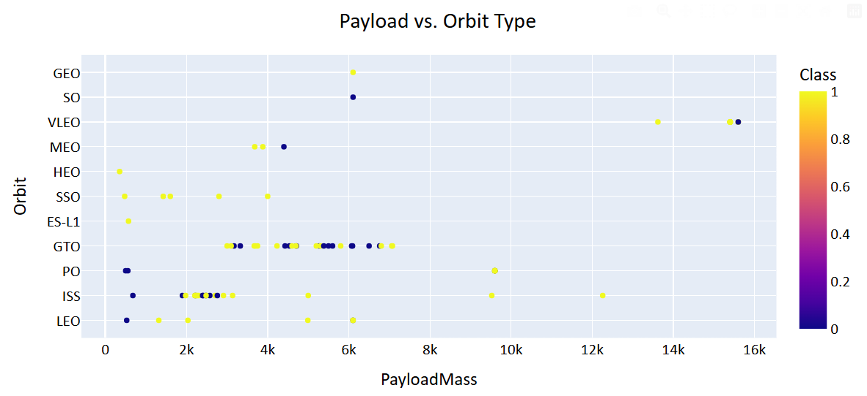
Payload vs. Orbit Type

Slide 23
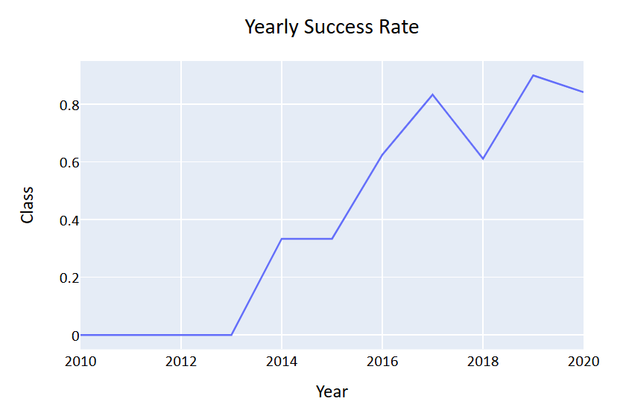
Launch Success Yearly Trend

Slide 24
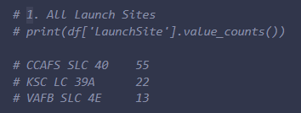
All Launch Site Names
This is an overview of all launch sites in the Spacex database.

Slide 25
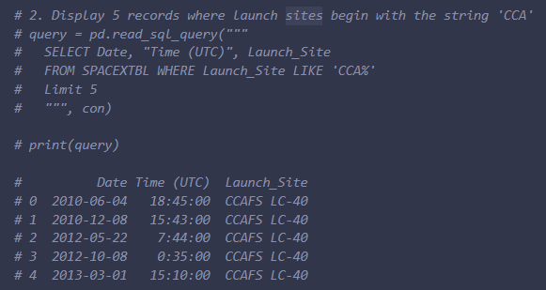
Launch Site Names Begin with 'CCA'
Below are 5 Locations where Launch Site begins with “CCA”

Slide 26
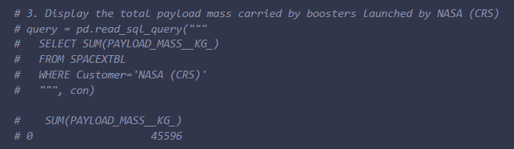
Total Payload Mass
Total Payload Mass was 45,596 Kg

Slide 27
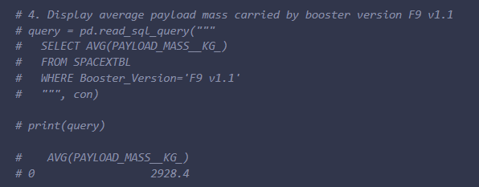
Average Payload Mass by F9 v1.1
Average Payload Mass was 2,928.4 Kg

Slide 28
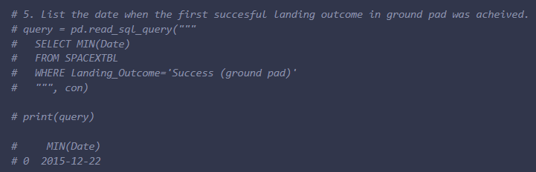
First Successful Ground Landing Date
First successful landing outcome was on December 22nd, 2022

Slide 29
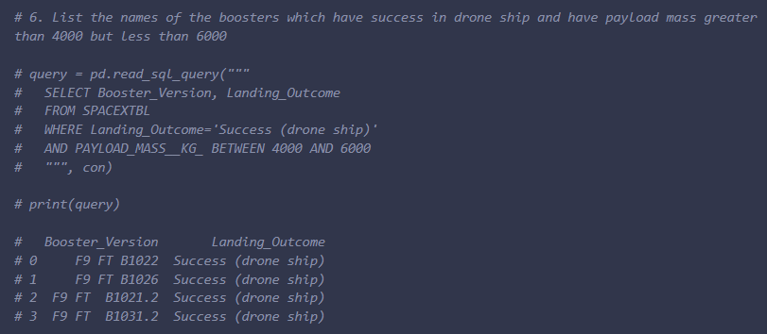
Successful Drone Ship Landing with Payload between 4000 and 6000
Boosters that have successfully laded on drone ship with a payload mass between 4,000 and 6,000 were:
F9 FT B1022
F9 FT B1026
F9 FT B1021.2
F9 FT B1031.2

Slide 30
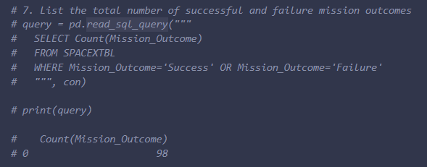
Total Number of Successful and Failure Mission Outcomes
Total Successful and Failure mission outcomes was 98

Slide 31
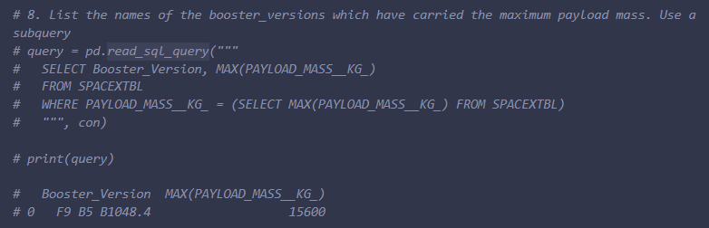
Boosters Carried Maximum Payload
The booster that carried the max payload mass was F9 B5 B1048.4

Slide 32
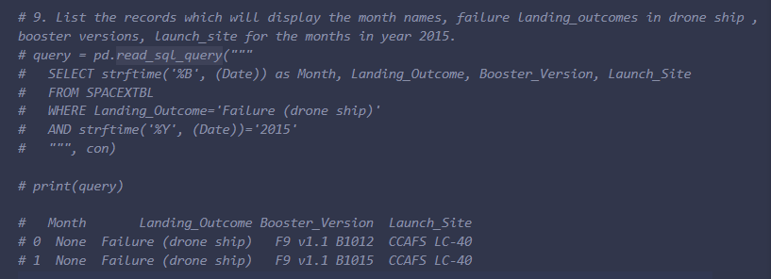
2015 Launch Records
Failed landing outcomes in drone ship, their booster versions, and launch site names for in year 2015:

Slide 33
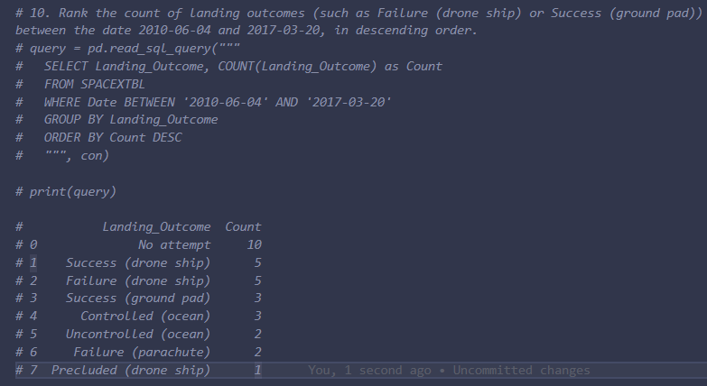
Rank Landing Outcomes Between 2010-06-04 and 2017-03-20
Count of landing outcomes between 2010-06-04 and 2017-03-20:

Slide 34

Section 3

Slide 35
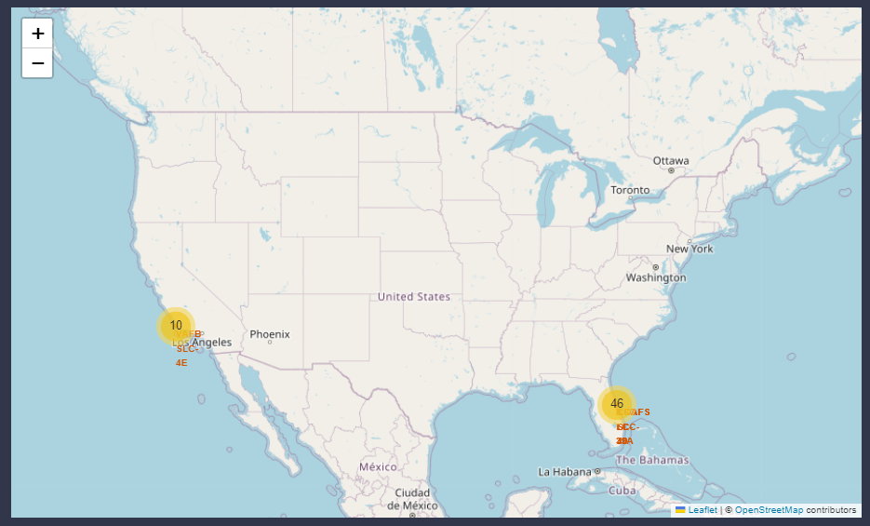
Launch Site Locations
In this folium map, you can see the launch site locations shown as marker clusters.

Slide 36
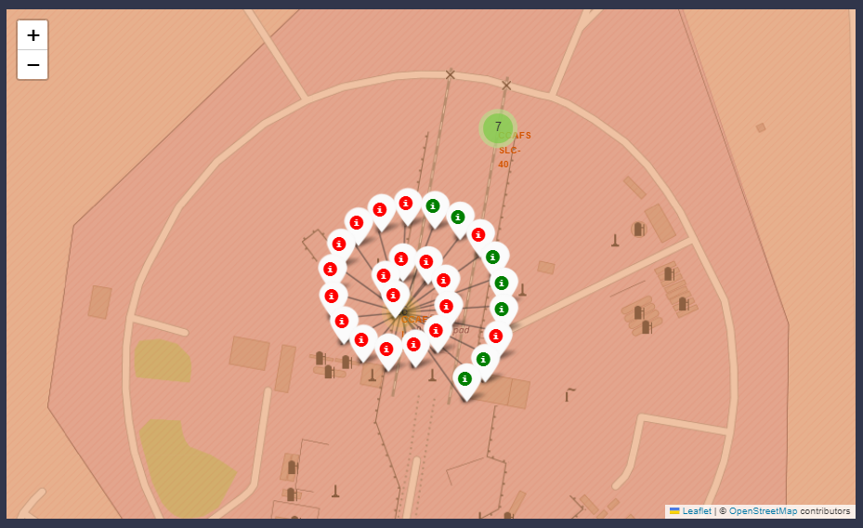
Launch Outcomes
Folium map showing successful landing outcomes as green and failed in red

Slide 37
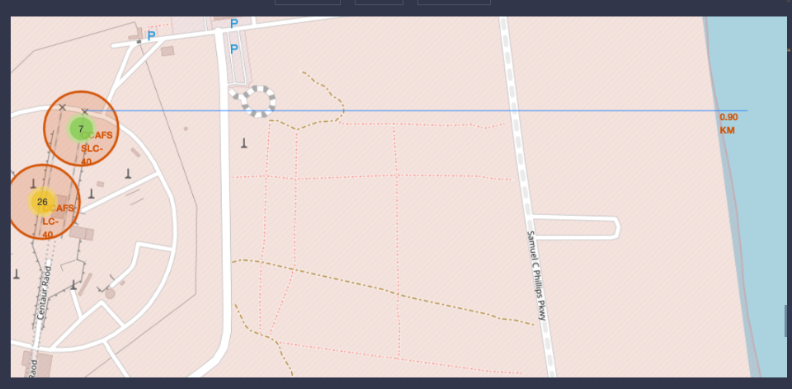
<Folium Map Screenshot 3>
Folium map showing selected launch site to its proximities such as railway, highway, coastline, with calculated distance.

Slide 38

Section 4

Slide 39
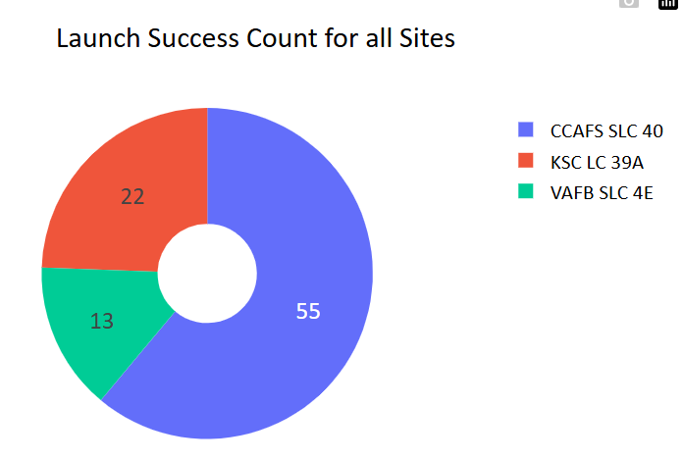
Successful Launch Outcomes by Site

Slide 40
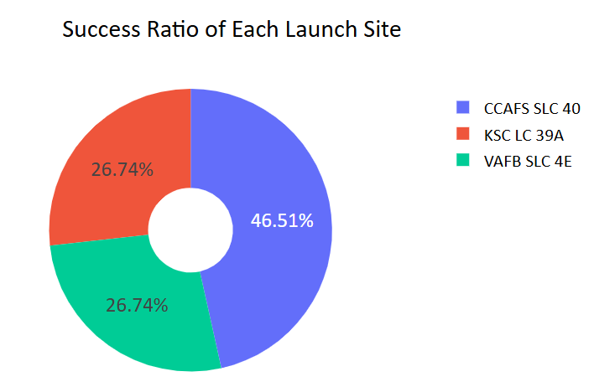
Success Rate by Launch Site
Piechart for the launch site with highest launch success ratio

Slide 41
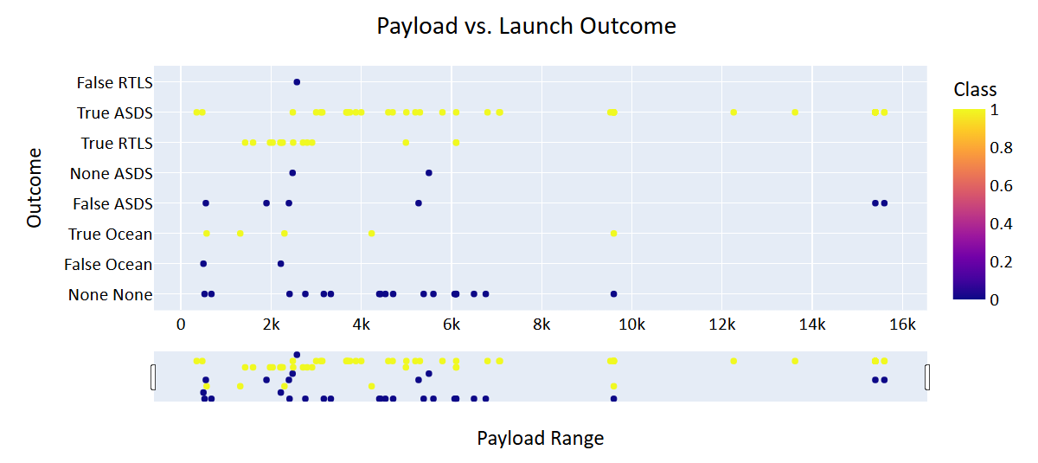
Payload vs. Launch Outcome
Show screenshots of Payload vs. Launch Outcome scatter plot for all sites, with different payload selected in the range slider

Slide 42

Section 5

Slide 43
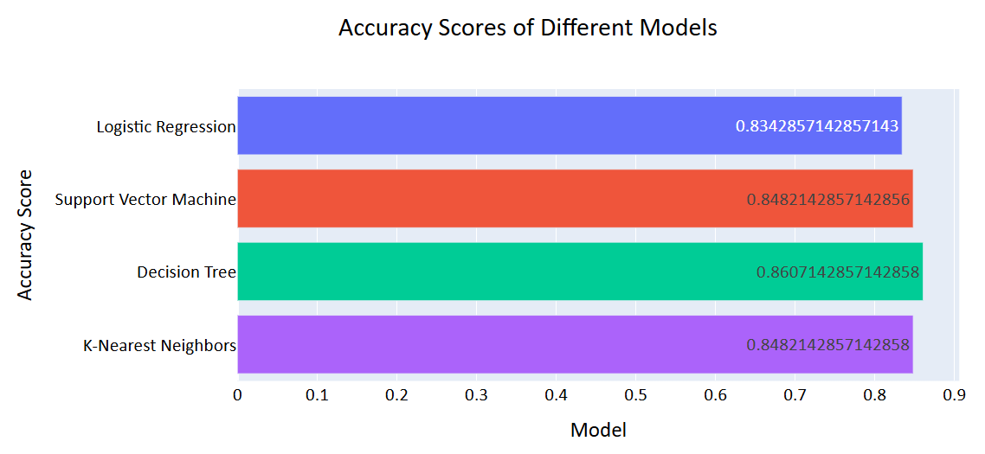
Classification Accuracy
Highest accuracy model is Decision Tree

Slide 44
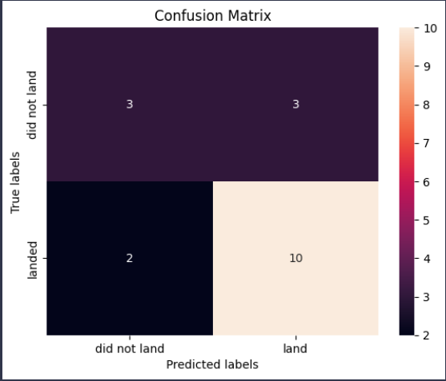
Confusion Matrix
Confusion Matrix for Decision Tree

Slide 45
Conclusions
Point 1
Point 2
Point 3
Point 4
…

Slide 46
Appendix
Include any relevant assets like Python code snippets, SQL queries, charts, Notebook outputs, or data sets that you may have created during this project

Slide 47


